Slide 1
DECODING DEATH
Predicting Death By US State

Slide 2
Project Participants
01
02
03
04
IAN LEE
NAVDEEP KAUR
PAUL KU
JEFF MORGAN
05
BYRON DE LEON

Slide 3
About
For Project 4, our team worked with machine learning (ML) with the other technologies we've learned solve, analyze, and visualize a project decoding opensource information to discover a problem worth solving, analyzing, or visualizing.

Slide 4
Introduction
Our group project attempts to analyze provisional counts of deaths by state and select causes for the years 2020-2023. The ultimate goal was to predict the most likely causes of death in each state for 2024.

Slide 5

Data Source
Weekly Provisional Counts of Deaths by State and Select Causes, 2020-2023
https://data.cdc.gov/NCHS/Weekly-Provisional-Counts-of-Deaths-by-State-and-S/muzy-jte6/about_data

Slide 6
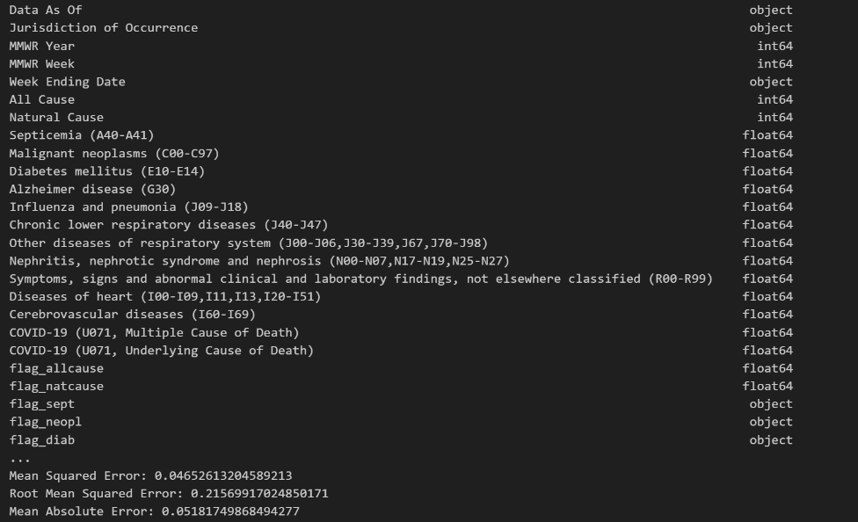
METHODOLOGY
Our Group stared by working with a Python script using pandas for data manipulation and scikit-learn for machine learning tasks, particularly regression analysis.

Slide 7

Breakdown of Data Processing
Do you know what helps you make your point clear? Lists like this one:
Converting the "Week Ending Date" column to datetime format.
Created new columns for year, month, and day extracted from the "Week Ending Date".
Aggregated the data by year, month, and jurisdiction of occurrence, summing up the "All Cause" column.
Handling Missing Values: You've printed the count of missing values in the aggregated dataset.
One-hot encoding was performed on the "Jurisdiction of Occurrence" column to encode the categorical variables.
Scikit-learn was used to standardize the numerical feature
The dataset was split the into training and testing sets.

Slide 8
Dependencies
Python Libraries: pandas, numpy, scikit-learn
Make sure to install these dependencies using the following command
pip install pandas numpy matplotlib scikit-learn

Slide 9
Modeling & Training
Modeling
(DecisionTreeRegressor)
Mean Squared Error (MSE)
Root Mean Squared Error (RMSE)
Mean Absolute Error (MAE)
R-squared.
(GridSearchCV) Finds the best hyperparameters for the decision tree regressor model.
Trained final decision tree model for best performance
Final Training
Notes:
We trained a decision tree regression model (DecisionTreeRegressor) on the training data and evaluated its performance on the testing data using metrics such as Mean Squared Error (MSE), Root Mean Squared Error (RMSE), Mean Absolute Error (MAE), and R-squared. Later, we performed hyperparameter tuning using grid search (GridSearchCV) to find the best hyperparameters for the decision tree regressor model.
Finally, we trained another decision tree regression model with the best hyperparameters found from grid search and evaluated its performance on the testing data.

Slide 10
Causes of Death
01
02
03
04
05
Heart Disease
Malignant Neoplasm
Coronavirus (COVID-19)
Range of conditions that affect the heart
Cancers
Infectious disease caused by the SARS-CoV-2 virus
Respiratory Disease
Cerebrovascular Disease
Asthma, Chronic Obstructive Pulmonary Disease (COPD)
Group of conditions that affect the blood vessels and blood flow in the brain and spinal cord.

Slide 11
Causes of Death
06
07
08
09
10
Alzheimer Disease
Diabetes mellitus
Nephritis
Degenerative Disease of the Nervous System
A metabolic disease, involving inappropriately elevated blood glucose levels
An Inflammatory Kidney Disease
Influenza/Pneumonia
Not Elsewhere Classified
Flu-Common Cause of Pneumonia

Slide 12



Slide 13

Tableau
You can replace the image on the screen with your own work. Just right-click on it and select “Replace image”

